Slide 1
2018 DA Lecture 2/3: Data pre-processing and Interpretation of clusters by comparing centers with grand means
Contents:
Quantification of categories
Data standardization
What is center: Minkowski’s family
Interpretation of clusters via centers
Validation of center using bootstrap
Comparing centers using bootstrap

Slide 2
Quantification of categories: Illustrative Data case
Companies characterized by mixed scale features; first three companies making product A, next three making product B, and the last two product C.
Company name | Income, $mln | MShare,% | NSup | EC | Sector
Aversiona Antyops Astonite | 19.0 29.4 23.9 | 43.7 36.0 38.0 | 2 3 3 | No No No | Utility Utility Manufacture
Bayermart Breaktops Bumchista | 18.4 25.7 12.1 | 27.9 22.3 16.9 | 2 3 2 | Yes Yes Yes | Utility Manufacture Manufacture
Civiok Cyberdam | 23.9 27.2 | 30.2 58.0 | 4 5 | Yes Yes | Retail Retail

Slide 3
Company Dataset
Metadata: Object names, Features and Domain knowledge
1) Income, $ Mln;
2) MShare - Market share , per cent;
3) NSup - Number of principal suppliers;
4) ECommerce - Yes or No;
5) Sector - (a) Retail, (b) Utility, and (c) Industrial.
Feature: Maps entities to feature values
(unlike variable in Math. Statistics or Mach. Learn.)
Quantitative scale: Arithmetic mean makes sense Examples: 1) Income, 2) MShare, 3) Nsup
Binary scale: 1/0 coding makes it quantitative (mean=proportion)

Slide 4
Company Dataset
Metadata: Object names, Features and Domain knowledge
1) Income, $ Mln;
2) MShare - Market share , per cent;
3) NSup - Number of principal suppliers;
4) ECommerce - Yes or No;
5) Sector - (a) Retail, (b) Utility, and (c) Industrial.
Feature: Maps entities to feature values
Quantitative scale: Arithmetic mean makes sense
Nominal scale: categories are exclusive, no relations (corresponds to partition of the set of objects)
Other scales not taught in this class

Slide 5
Company dataset
Company name | Income, $mln | MShare,% | NSup | EC | Sector
Aversiona Antyops Astonite | 19.0 29.4 23.9 | 43.7 36.0 38.0 | 2 3 3 | No No No | Utility Utility Manufacture
Bayermart Breaktops Bumchista | 18.4 25.7 12.1 | 27.9 22.3 16.9 | 2 3 2 | Yes Yes Yes | Utility Manufacture Manufacture
Civiok Cyberdam | 23.9 27.2 | 30.2 58.0 | 4 5 | Yes Yes | Retail Retail
Data analysis issues:
-

Slide 6
Company dataset
Company name | Income, $mln | MShare,% | NSup | EC | Sector
Data analysis issues:
How to map companies to screen, to reflect similarity in distances between points? (Summarization)
Would clustering of companies reflect the product? What features would be involved? (Summarization)
Can rules be derived to predict the product for a company coming outside of the table? (Correlation)
Is there any relation between the structural features (NSup, EC, Sector) and market related features (Income, MShare)? (Correlation)

Slide 7
Company Dataset: Quantification
Case 1: Companies 4
Company name | Income, $mln | MShare,% | NSup | EC | Sector
Aversiona Antyops Astonite | 19.0 29.4 23.9 | 43.7 36.0 38.0 | 2 3 3 | No No No | Utility Utility Manufacture
Bayermart Breaktops Bumchista | 18.4 25.7 12.1 | 27.9 22.3 16.9 | 2 3 2 | Yes Yes Yes | Utility Manufacture Manufacture
Civiok Cyberdam | 23.9 27.2 | 30.2 58.0 | 4 5 | Yes Yes | Retail Retail
Quantitative coding: Each category is made into a 1/0 binary (dummy) feature “Does it hold? 1 if Yes, 0 if No.”
Entity | Income | MShar | NSup | EC? | Util? | Manu? | Retail?
1 2 3 | 19.0 29.4 23.9 | 43.7 36.0 38.0 | 2 3 3 | 0 0 0 | 1 1 0 | 0 0 1 | 0 0 0
4 5 6 | 18.4 25.7 12.1 | 27.9 22.3 16.9 | 2 3 2 | 1 1 1 | 1 0 0 | 0 1 1 | 0 0 0
7 8 | 23.9 27.2 | 30.2 58.0 | 4 5 | 1 1 | 0 0 | 0 0 | 1 1
Company data 8×5 converted into quantitative format 8×7

Slide 8
Pre-processing: - quantification - filling in missings (not covered) - standardization
Standardisation:
shift of the origin to a to compare data with a norm
rescaling by relating to b to make features comparable
Y_{iv} = (X_{iv} –a_{v})/b_{v}
X - original data
Y – standardized data
a_{v} – shift of the origin, typically, the average
b_{v} – rescaling factor, traditionally the standard deviation (from statistics perspective), but range may be better

Slide 9
Company Dataset: Standardization
Company data 8×5 converted to the quantitative format 8×7
# | Inco | MSch | NSup | EC | Util | Indu | Reta
1 2 3 | 19.0 29.4 23.9 | 43.7 36.0 38.0 | 2 3 3 | 0 0 0 | 1 1 0 | 0 0 1 | 0 0 0
4 5 6 | 18.4 25.7 12.1 | 27.9 22.3 16.9 | 2 3 2 | 1 1 1 | 1 0 0 | 0 1 1 | 0 0 0
7 8 | 23.9 27.2 | 30.2 58.0 | 4 5 | 1 1 | 0 0 | 0 0 | 1 1
Three standardizations:
(i). (ii) and (iii)
Why are that many, and what is the need in data standardization?
Goal: to sharpen the data structure
# | Inco | MSch | NSup | EC | Util | Man | Reta
1 2 3 | 19.0 29.4 23.9 | 43.7 36.0 38.0 | 2 3 3 | 0 0 0 | 1 1 0 | 0 0 1 | 0 0 0
4 5 6 | 18.4 25.7 12.1 | 27.9 22.3 16.9 | 2 3 2 | 1 1 1 | 1 0 0 | 0 1 1 | 0 0 0
7 8 Mean | 23.9 27.2 22.45 | 30.2 58.0 34.12 | 4 5 3.00 | 1 1 .625 | 0 0 .375 | 0 0 .375 | 1 1 0.25
Data standardization in DA (unlike in Math. Stat.):
Feature centering: to look at feature values against a “normal” backdrop
Feature normalization: to balance feature weights

Slide 10
Company Dataset: Standardization (i)
-3.45 9.58 -1 -0.62 0.62 -0.38 -0.25
6.95 1.88 0 -0.62 0.62 -0.38 -0.25
1.45 3.88 0 -0.62 -0.38 0.62 -0.25
-4.05 -6.22 -1 0.38 0.62 -0.38 -0.25
3.25 -11.82 0 0.38 -0.38 0.62 -0.25
-10.35 -17.22 -1 0.38 -0.38 0.62 -0.25
1.45 -3.92 1 0.38 -0.38 -0.38 0.75
4.75 23.88 2 0.38 -0.38 -0.38 0.75
Structure of data at standardization (i): centering
Color/shape corresponds
to the product (A,B,C)
This structure has nothing to do with product

Slide 11
Company Dataset: Standardization (ii)
-0.20 0.23 -0.33 -0.62 0.62 -0.38 -0.25
0.40 0.05 0 -0.62 0.62 -0.38 -0.25
0.08 0.09 0 -0.62 -0.38 0.62 -0.25
-0.23 -0.15 -0.33 0.38 0.62 -0.38 -0.25
0.19 -0.29 0 0.38 -0.38 0.62 -0.25
-0.60 -0.42 -0.33 0.38 -0.38 0.62 -0.25
0.08 -0.10 0.33 0.38 -0.38 -0.38 0.75
0.27 0.58 0.67 0.38 -0.38 -0.38 0.75
Structure of data at standardization (ii), centering and normalizing by range
Color/shape correspond to the product (A,B,C)
This structure somewhat corresponds to product

Slide 12
Company Dataset: Standardization (iii)
-0.20 0.23 -0.33 -0.62 0.36 -0.22 -0.14
0.40 0.05 0 -0.62 0.36 -0.22 -0.14
0.08 0.09 0 -0.62 -0.22 0.36 -0.14
-0.23 -0.15 -0.33 0.38 0.36 -0.22 -0.14
0.19 -0.29 0 0.38 -0.22 0.36 -0.14
-0.60 -0.42 -0.33 0.38 -0.22 0.36 -0.14
0.08 -0.10 0.33 0.38 -0.22 -0.22 0.43
0.27 0.58 0.67 0.38 -0.22 -0.22 0.43
Structure of data at standardization (iii): (ii)+ further normalizing
Sector features by sqrt(3)
Color/shape corresponds to the product (A,B,C)
This structure corresponds
to product quite well !

Slide 13
Week2. What is center,1
Consider a feature over N entities (transposed)
x = (x₁, x₂, …, x_{N})
Data analysis view
Def. Center of x is a value c satisfying equations
x_{i} = c + e_{i}, for all i=1,2,…, N
at as small residuals e_{i} as possible
Def. L_{p}=[|e₁|^{p}+|e₂|^{p}+…+ |e_{N}|^{p} ]/N
Minkowski criterion: min L_{p}

Slide 14
Week2. What is center, 2
Data analysis view: Minkowski p-center (p ≥ 1)
Minimize L_{p}=[|c-x₁|^{p}+|c-x₂|^{p}+…+ |c-x_{N}|^{p} ]/N
with respect to all possible c
At different p, different solutions!
L_{p} is a measure of spread of the feature around center

Slide 15
Week2. What is center, 2
Data analysis view: Minkowski p-center (p ≥ 1)
Minimize L_{p}=[|c-x₁|^{p}+|c-x₂|^{p}+…+ |c-x_{N}|^{p} ]/N
with respect to all possible c
Take p=2. Then L_{p} is quadratic. First-order minimum condition can be applied, it leads to optimal
c=Mean(x)!
At this c,
L₂ is the square of the standard deviation!
(The minimum L₂ is referred to as the variance, and its square root, as the standard deviation.)

Slide 16
Week2. What is center: Minkowski p-center (p ≥ 1)
Minimize L_{p}=[|c-x₁|^{p}+|c-x₂|^{p}+…+ |c-x_{N}|^{p} ]/N
Take p=1. Then
L₁=[|c-x₁|+|c-x₂|+…+ |c-x_{N}|]/N
It can be proven that the minimum of L₁ is reached at c being the median! Then the minimum of L₁ should be used as the corresponding spread.
Take p tending to infinity and the p-th root of Lp, then c tends to midrange.

Slide 17
Minkowski distance: curve x^{p}+y^{p}=1 at different p
P=5
P=3
P=2
P=1.5
P=1

Slide 18
Week2. What is center, 5
Feature (transposed)
19.0 29.4 23.9 18.4 25.7 12.1 23.9 27.2
Minkowski p Spread Center
Infinity Range Midrange
17.3 20.75
2 Standard
deviation Mean
5.26 22.45
1 Average
deviation Median
4.1 23.9

Slide 19
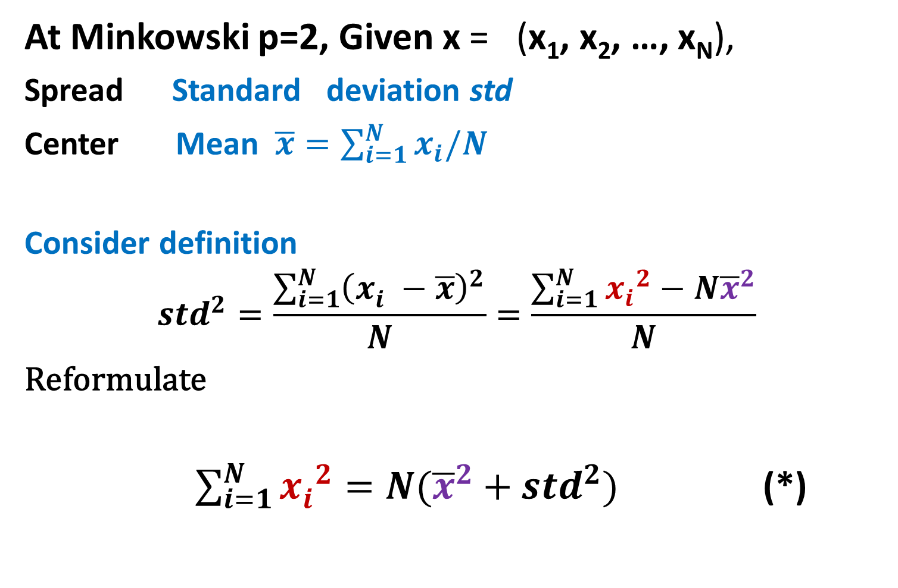
Week 2. What is center, 6
At Minkowski p=2, Given x = (x₁, x₂, …, x_{N}),
Spread Standard deviation std
Center Mean $\overline{x}=\sum_{i=1}^{N}{x_{i}/N}$
Consider definition
$${std}^{2}=\frac{\sum_{i=1}^{N}{{\left(x_{i}^{} −\overline{x}\right)}^{2}}}{N}=\frac{\sum_{i=1}^{N}{{x_{i}}^{2}−{N\overline{x}}^{2}}}{N}$$
Reformulate
$\sum_{i=1}^{N}{{x_{i}^{}}^{2}}={N(\overline{x}}^{2}+{std}^{2})$ (*)

Slide 20
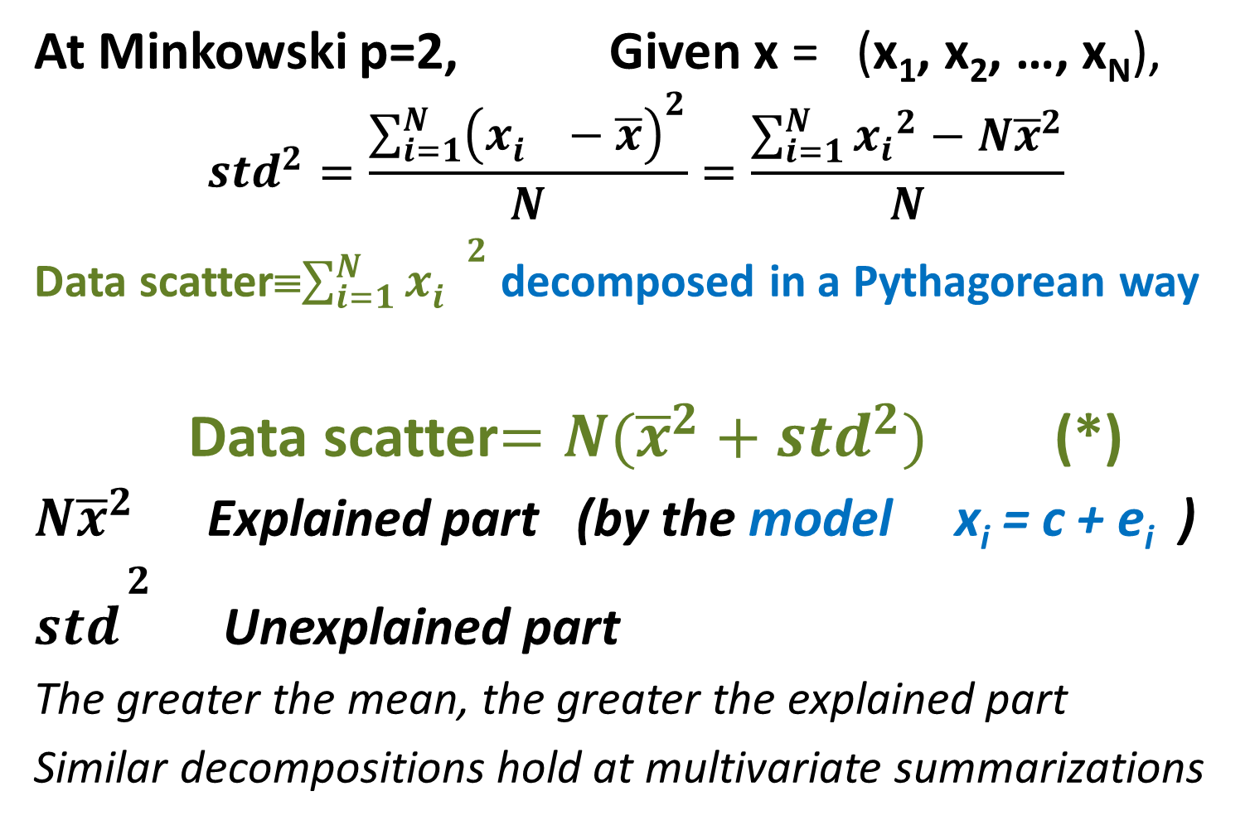
Week 2. What is center, 6
At Minkowski p=2, Given x = (x₁, x₂, …, x_{N}),
$${std}^{2}=\frac{\sum_{i=1}^{N}{{\left(x_{i}^{} −\overline{x}\right)}^{2}}}{N}=\frac{\sum_{i=1}^{N}{{x_{i}}^{2}−{N\overline{x}}^{2}}}{N}$$
Data scatter≡$\sum_{i=1}^{N}{{x_{i}^{}}^{2}}$ decomposed in a Pythagorean way
Data scatter$={N(\overline{x}}^{2}+{std}^{2})$ (*)
${N\overline{x}}^{2}$ Explained part (by the model x_{i} = c + e_{i} )
${std}^{\begin{aligned}2 \\ \end{aligned}}$ Unexplained part
The greater the mean, the greater the explained part
Similar decompositions hold at multivariate summarizations

Slide 21
Week 2. What is center, 7
p Center Comment
2 Mean Intuitive;
Gaussian
Sensitive to removal/addition of outliers
Median Stable over removal/addition of outliers
∞ Midrange Does not depend on the distribution shape
Sensitive to change of range boundary points
Other values of p can be beneficial too, but we know very little of this

Slide 22
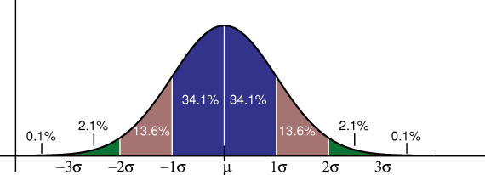
Week2. What is center: Probabilistic perspective
Gaussian density function
p(x)=C exp[-(x-a)²/2σ²]

Slide 23
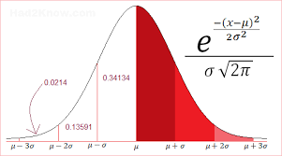
Week2. What is center: Probabilistic perspective
Gaussian density function

Slide 24
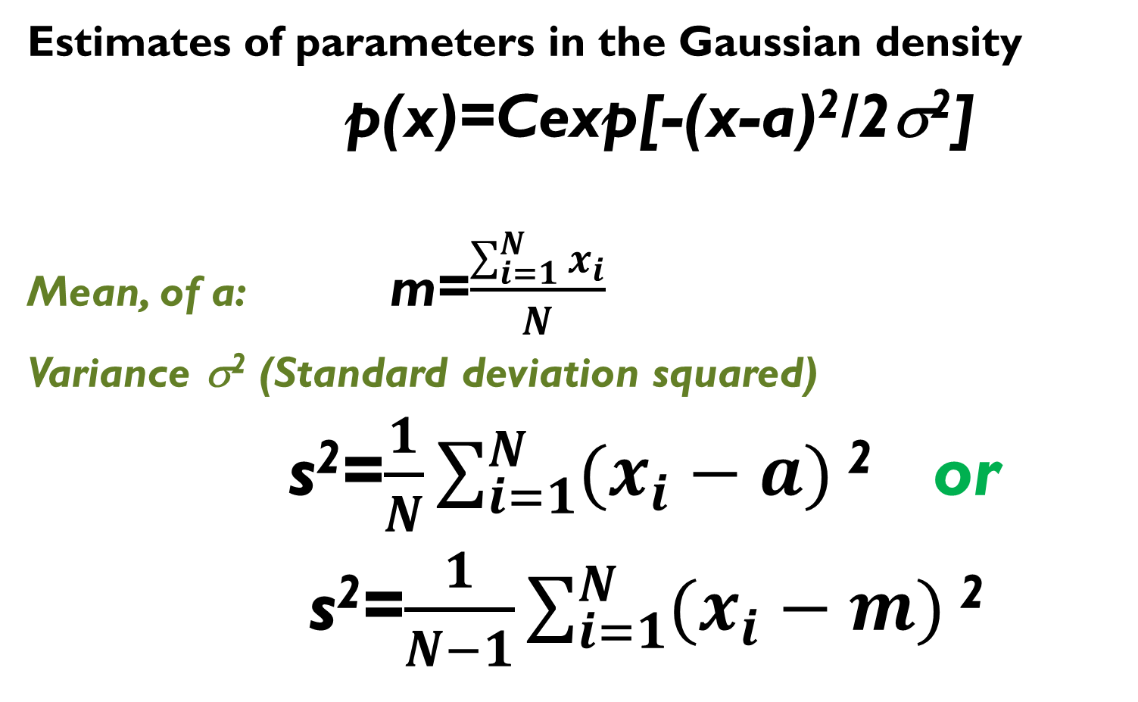
Week2. What is center: Probabilistic perspective
Estimates of parameters in the Gaussian density
p(x)=Cexp[-(x-a)²/2σ²]
Mean, of a: m=$\frac{\sum_{i=1}^{N}{x_{i}}}{N}$
Variance σ² (Standard deviation squared)
s²=$\frac{1}{N}\sum_{i=1}^{N}{(x_{i}−a)}$ ² or
s²=$\frac{1}{N−1}\sum_{i=1}^{N}{(x_{i}−m)}$ ²

Slide 25
Interpretation of clusters, 1
Iris data:
w1 w2 w3 w4
1 5.1 3.5 1.4 0.3
2 4.4 3.2 1.3 0.2
3 4.4 3.0 1.3 0.2
4 5.0 3.5 1.6 0.6
5 5.1 3.8 1.6 0.2
……………………….
150 6.5 3.2 5.1 2.0

Slide 26
Interpretation of clusters, 1I
Iris data: 150 x 4
Taxon 1: 1:50
Taxon 2: 51:100
Taxon 3: 101:150

Slide 27
Interpretation of clusters, III
Means
w1 w2 w3 w4
T1 5.0060 3.4280 1.4620 0.2460
T2 5.9360 2.7700 4.2600 1.3260
T3 6.5880 2.9740 5.5520 2.0260
G 5.8433 3.0573 3.7580 1.1993

Slide 28
Interpretation of clusters, IV
Relative Difference: 100*(CMean –GMean)/GMean
w1 w2 w3 w4
T1 -14.3297 12.1239 -61.0963 -79.4886
T2 1.5859 -9.3982 13.3582 10.5614
T3 12.7439 -2.7257 47.7382 68.9272
G 0 0 0 0

Slide 29
Interpretation of clusters, V
Relative Difference: 100*(CMean –GMean)/GMean
w1 w2 w3 w4
T1 -14.3297 12.1239 -61.0963 -79.4886
small petal
T2 1.5859 -9.3982 13.3582 10.5614
pretty average
T3 12.7439 -2.7257 47.7382 68.9272
big petal

Slide 30
Interpretation of clusters, VI
Relative Difference: 100*(CMean –GMean)/GMean
w1 w2 w3 w4
T1 small petal
T2 pretty average
T3 big petal
No sepal in interpretation – probably should be
removed from clustering process

Slide 31
Interpretation of clusters, VII
Relative Difference: 100*(CMean –GMean)/GMean
T1 small petal
T2 pretty average
T3 big petal
Why is interpretation important?
In the very end, clustering is accepted if related to existing domain knowledge

Slide 32
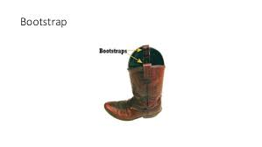
Bootstrapping for comparing means

Slide 33
Week 2. 1D: Part5 Computational validation of Mean using bootstrap 1
Consider a feature, say x=iris(:,1) % 1st column of Iris data
Its histogram hist(x,15):
rather far from Gaussian
Its mean m = 5.8433
std=0.8253

Slide 34
Week 2. 1D: Part5 Computational validation of Mean using bootstrap 1
Consider a feature, say x=iris(:,1)
Its mean m = 5.8433
std=0.8253
If one wants to reasonably speculate of plausible boundaries within which Mean should be expected at any possible set of iris specimen,
what should they suggest?
m±std? Or m±2*std? Or m±3*std? Or what?

Slide 35
Week 2. 1D: Part5 Computational validation of Mean using bootstrap 2
Plausible boundaries for mean?
One way to go: using classical math statistics
Say, assume x is a random independent sample from a Gaussian distribution with a=5.8433 and σ=0.8253
Proven: is Gaussian too, with a= and σ=std/ √N

Slide 36
Week 2. 1D: Part5 Computational validation of Mean using bootstrap 3
Consider a feature, say x=iris(:,1)
Its mean m = 5.8433, std=0.8253
Plausible boundaries for m? 95%
One way to go: using classical math statistics
Assume x is a random independent sample from a Gaussian distribution with a=5.8433 and σ=0.8253:
m is Gaussian too, with a=m and σ=std/N^{½} (N=150)
Therefore, with 95% confidence
Lb= a - 1.96*std /N^{½}= 5.7108
Rb= a + 1.96*std /N^{½}= 5.9759
Conclusion:
m within [5.7108, 5.9759] with confidence 95% (under Gaussian assumption, possibly, unjustified)

Slide 37
Week 2. 1D: Part5 Computational validation of Mean using bootstrap 4
Plausible boundaries for m?
Another way to go: using computing power
Bootstrap
Multiple entity samples of same size N (with replacement)
Meaning: indices are sampled
MatLab:
>> N=4;M=3; r=ceil(N*rand(N,M))
1 4 4 N, the number of entities
r= 3 1 4 M, the number of samples
3 1 3 First sample: entity 1, entity 3 (twice),
2 3 1 entity 2 (entity 4 is missed: why?)

Slide 38
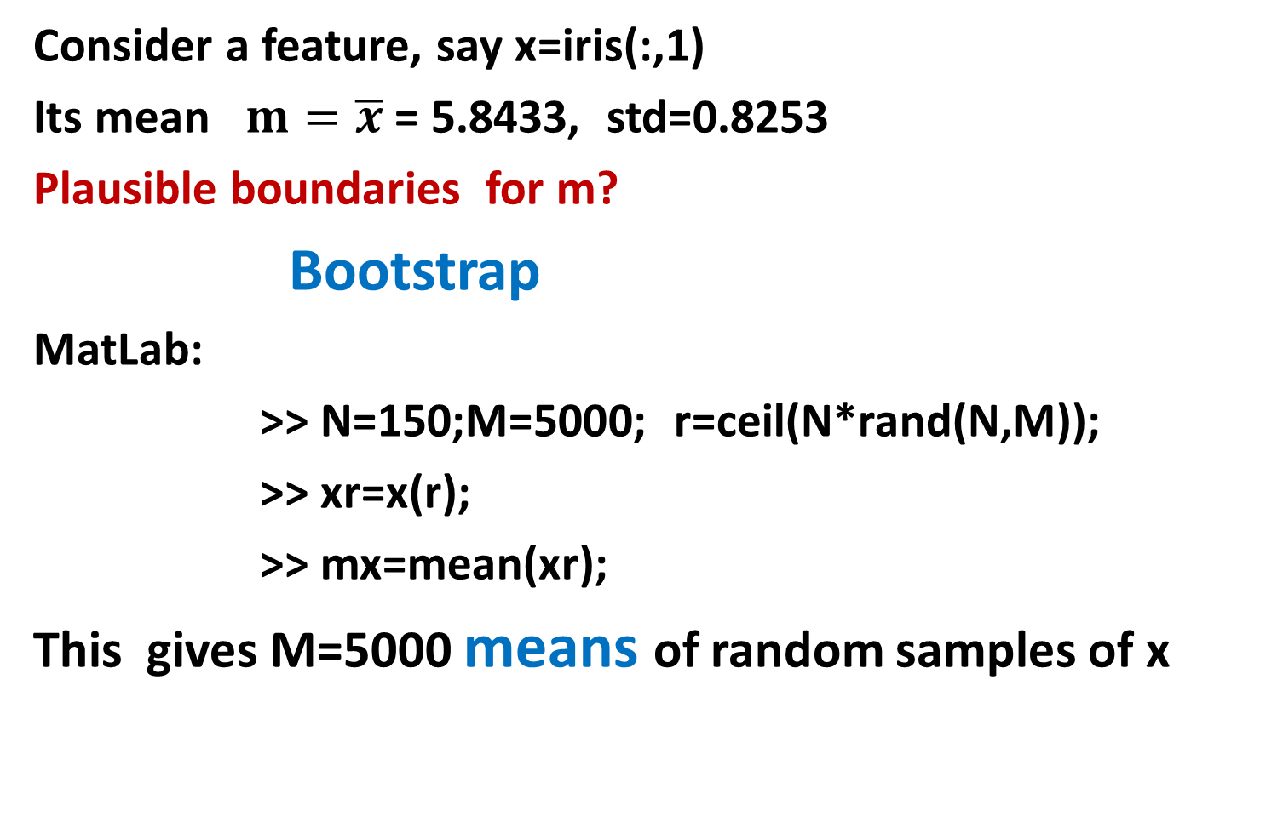
Week 2. 1D: Part5 Computational validation of Mean using bootstrap 5
Consider a feature, say x=iris(:,1)
Its mean = 5.8433, std=0.8253
Plausible boundaries for m?
Bootstrap
MatLab:
>> N=150;M=5000; r=ceil(N*rand(N,M));
>> xr=x(r);
>> mx=mean(xr);
This gives M=5000 means of random samples of x

Slide 39
Week 2. 1D: Part5 Computational validation of Mean using bootstrap 6
Plausible boundaries for m?
Bootstrap
>> N=150;M=5000; r=ceil(N*rand(N,M));
>> xr=x(r); mr=mean(xr);
Histogram of M=5000 means
Quite Gaussian, n’est ce pas?

Slide 40
Week 2. 1D: Part5 Computational validation of Mean using bootstrap 8
Feature x=iris(:,1); = 5.8433, std=0.8253
Plausible boundaries for m?
Bootstrap Histogram of M=5000 means mr
A. Pivotal method
(95% confidence)
Assume mr be Gaussian
>> mmr=mean(mr); % 5.8444
>> smr=std(mr); % 0.0675
>> lbp=mmr-1.96*smr; % 5.7121
>> rbp=mmr+1.96*smr; % 5.9767

Slide 41
Week 2. 1D: Part5 Computational validation of Mean using bootstrap 8
Feature x=iris(:,1); = 5.8433, std=0.8253
Plausible boundaries for m?
Bootstrap Histogram of M=5000 means mr
B. Non-pivotal method
(95% confidence)
Take 2.5% and 97.5% percentiles
as the boundaries
1% of 5000 is 50;
2.5% is 125; 97.5% is 4875
>> smr=sort(mr); % sorting
>> lbn=somr(126); % 5.7120
>> rbn=somr(4875); % 5.9773

Slide 42
Week 2. 1D: Part5 Computational validation of Mean using bootstrap 9
Consider a feature, say x=iris(:,1)
Its mean = 5.8433, std=0.8253
Plausible boundaries for m
with confidence 95%?
Three different methods – m must be within :
[5.7108, 5.9759] (under Gaussian assumption)
[5.7121, 5.9767] (Bootstrap pivotal)
[5.7120, 5.9773] (Bootstrap non-pivotal)
with 95% confidence
I can see no difference between these; there is an issue with the choice of 95%, too…

Slide 43
Comparison with Bootstrap,1
Compare mean Sepal length in Taxa 2 and 3:
Bootstrap distributions of M trial means in T1 and in T2
Quotients Q=M(T1)/M(T2) or
Differences D=M(T1)−M(T2) over all M trials
95% confidence interval I for Q or D
Checking whether unity, for Q, or zero, for D, is in I or not. If not, one M is greater than the other.

Slide 44
Interpretation of clusters, III
Means
w1 w2 w3 w4
T1 5.0060 3.4280 1.4620 0.2460
T2 5.9360 2.7700 4.2600 1.3260
T3 6.5880 2.9740 5.5520 2.0260
G 5.8433 3.0573 3.7580 1.1993

Slide 45
Comparison with Bootstrap,1I
Compare mean Sepal length in Taxa 2, 3, All set:
>> n=150;m=5000;r=ceil(n*rand(n,m));
>> x=iris(:,1); xr=x(r); mr=mean(xr);%All set
In Taxa:
>> for k=1:5000; y=r(:,k); p=ismember(y,t{2}); n2=sum(p);y2=sum(p.*x(y));m2(k)=y2/n2;end
>> for k=1:5000; y=r(:,k); p=ismember(y,t{3}); n3=sum(p); y3=sum(p.*x(y));m3(k)=y3/n3;end
mr m2 m3 – 5000-strong bootstrap means

Slide 46
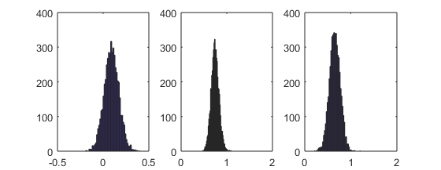
Comparison with Bootstrap,III
Compare mean Sepal length in Taxa 2, 3, All set:
m2-mr m3-mr m2 -m3 bootstrap means

Slide 47
Lecture’s summary
Three scale types
Quantification of a mixed scale data table
Data standardization
Minkowski’s center
Minkowski’s centers at p=1, 2, ∞
Decomposition of the data scatter at p=2
Gaussian distribution and its parameters
Confidence interval
Bootstrap: what is it?
Bootstrap for validating the mean: pivotal, nonpivotal
Bootstrap for comparing two means

Slide 48
Quiz for the courageous:
Give an algorithm for finding Minkowski’s center at any p>1.
Prove that the median is a Minkowski’s center at p=1.
Consider a zero-one feature f; given a cluster partition of the object set, put down a formula for cluster centers.
Can you explain the meaning of a confidence interval to the user?
I recommend comparing within-cluster centers with grand mean

Slide 49
HomeWork 2, I
1. Choose 3-6 features, Explain the choice, Apply K-means:
At K=5
At K=9
In both cases: 10 or more random initializations, chose the best over the K-means criterion
2. Interpret each found partition by using features from the data table. Explain why you consider one of them better than the other in this perspective.

Slide 50
HomeWork 2, II
3. Take one of the partitions
3.1. Compare one of the features between two clusters with using bootstrap
3.2. Take a feature, find the 95% confidence interval for its grand mean by using bootstrap
3.3. Take a cluster, and compare the grand mean with the within-cluster mean for the feature by using bootstrap
Note: each application of bootstrap should be done in both, pivotal and non-pivotal, versions

